Slide 1
Leveraging Machine Learning for Clinical Decision Support
UmaDevi malladi

Slide 2
Agenda
Case Study
Project Charter
Objective
Data Collection
Data Preprocessing
Predictive Modelling
Evaluation
Feature importance
Overall insights

Slide 3
Case Study
A recent actual cohort study done on pediatric patients suspected appendicitis admitted with abdominal pain to Children’s Hospital St. Hedwig in Regensburg, Germany, between 2016 and 2021.
Managing appendicitis in children is still lacking international consensus. This is due to the lack of defined international pediatric appendicitis management recommendations and the unavailability of data-driven studies.
In clinical practice, heuristic scoring methods are frequently employed to determine patient urgency. Most paediatric admissions for stomach discomfort are for appendicitis. Preschoolers have much higher perforation rates than older kids or adults. However, nonsurgical antimicrobial therapies are showing similar efficacy. The longer one wait to treat appendicitis, the greater the danger of developing life-threatening problems. So hospital doctors frequently utilize risk assessment algorithms to determine patient urgency.
https://archive.ics.uci.edu/dataset/938/regensburg+pediatric+appendicitis

Slide 4
Project Charter
Problem Statement : Appendicitis is a common cause of hospital admissions in children.
Lifetime risk: 6-9%, with peak incidence at ages 10-19.
Preschoolers face higher perforation rates than older children or adults.
Current Challenges:
Lack of international consensus on pediatric appendicitis management.
Heavy reliance on heuristic scoring methods for urgency assessment.
Impact:
Late diagnosis increases the risk of life-threatening complications.
Surgeries.

Slide 5
Objective
Objective:
Develop a machine learning-based Clinical Decision Support System (CDSS):
Purpose: Assist clinicians in diagnosing and managing pediatric appendicitis.
Goals:
Reduce the number of non-critical surgeries.
Optimize patient care and resource utilization.
Enhance risk assessment accuracy
.

Slide 6
Data Collection
Data Sources: Electronic health records (EHRs) of pediatric patients.
Historical data on appendicitis cases, treatments, and outcomes.
Variables: Demographics: Age, gender, BMI, Height, Weight.
Clinical: Symptoms, lab test results (Appendix_on_Ultra Sound, Appendix_Diameter, Migratory_Pain, Lower_Right_Abd_Pain, Contralateral_Rebound_Tenderness, Coughing_Pain, Nausea, Loss_of_Appetite, Body_Temperature, WBC_Count , Neutrophil_Percentage , Neutrophilia RBC_Count, Hemoglobin ,RDW, Thrombocyte_Count ,Ketones_in_Urine, RBC_in_Urine WBC_in_Urine, CRP , Dysuria ,Stool ,Peritonitis, Psoas_Sign, Ipsilateral_Rebound_Tenderness, US_Performed Free_Fluids ).
Imaging: Ultrasound, CT findings.
Outcomes: Surgery vs. non-surgical treatment, complications.
Challenges: Missing data in EHRs.
Variability in clinical practices across hospitals.

Slide 7
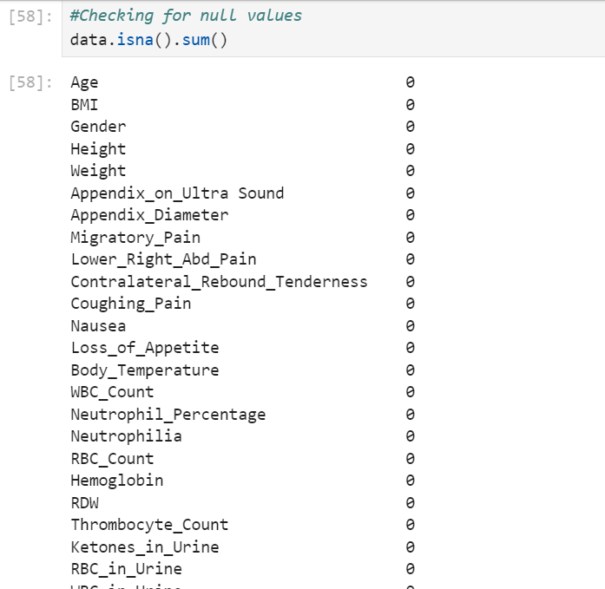
Data Preprocessing
Handle missing values:
Checked for null values and there is no null value in all the columns.
Patient records: 781
Attributes count- 37
Time period hospital records taken: 2016 to 2021

Slide 8
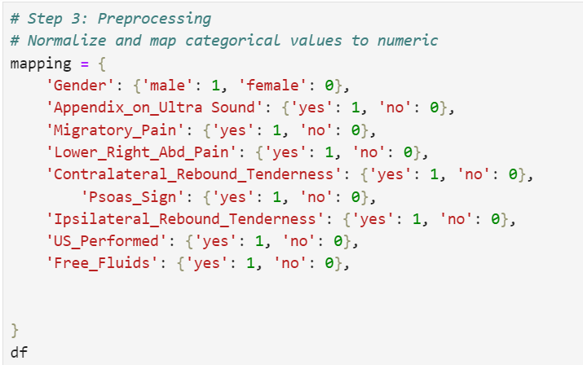
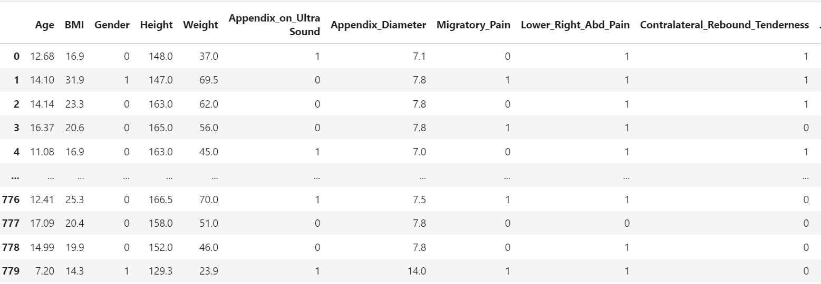
Data Preprocessing
Encode categorical variables:
Converting the categorical fields- to 0 & 1.
Gender
Appendix_on_Ultra Sound’
Migratory_Pain
Lower_Right_Abd_Pain
Contralateral_Rebound_Tenderness
Psoas_Sign
Ipsilateral_Rebound_Tenderness
US_Performed
Free_Fluids

Slide 9
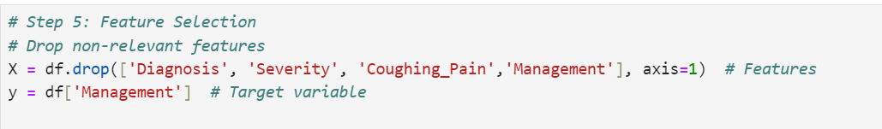
Feature Selection
Feature Selection: Identify critical predictors of appendicitis (e.g., lab results, imaging data).

Slide 10
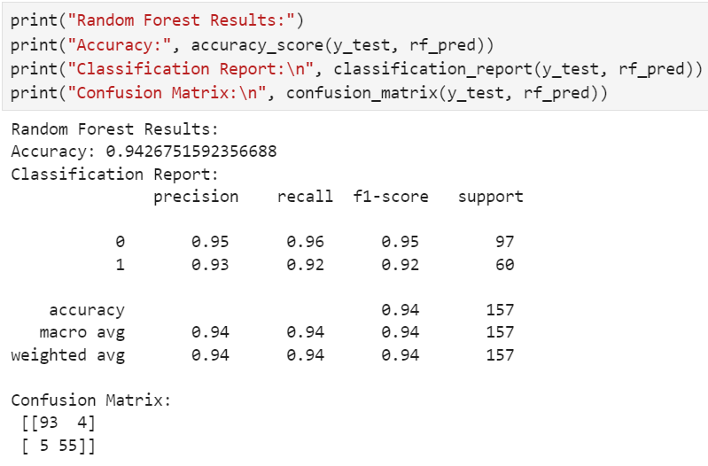
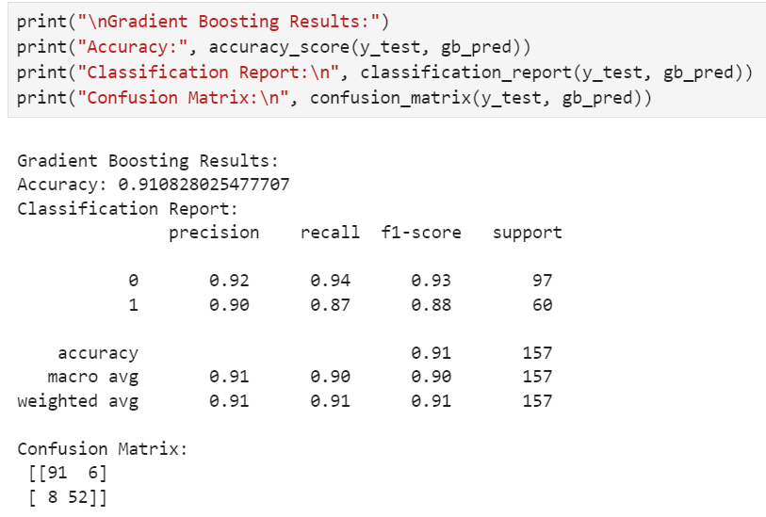
Model Development
Algorithms: Random Forest, gradient boosting and logistic regression
Train-test split: 80-20%.

Slide 11
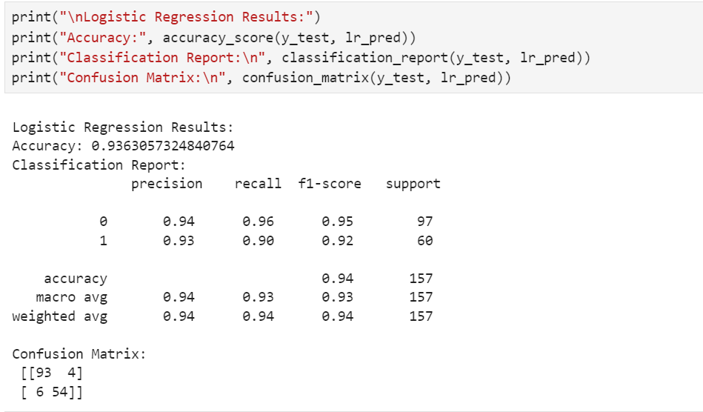
Model Development
Algorithms: Random Forest, gradient boosting and logistic regression
Comparing all the three models , high accuracy in prediction resulted in random forest model- 94.26%

Slide 12
Model Evaluation
Model Performance Overview: Selected Random forest model with high accuracy – 94.26%
Accuracy:
The model achieved an accuracy of 94.26% on the test set. This indicates that the model correctly classified 94.26 % of the cases as either requiring surgical or non-surgical treatment.
Precision: class 0- no surgery and 1- Surgery class 0: 95% of the cases predicted as non –critical and no surgery required were correct.
Class-1 93% of the cases predicted as critical and require surgery were correct.

Slide 13
Model Evaluation
3. Recall:
Class 0- No Surgery 96% of the cases are correctly identified as no surgery required.
Class 1- 92% of the cases are correctly identified as critical and surgery needed.
4. f1-Score:
Class 0 (No Surgery): 0.95, indicating a good balance between precision and recall.
Class 1 (Surgery Required): 0.92, showing a slightly lower balance between precision and recall for surgery cases.

Slide 14
Model Evaluation
Confusion Matrix:
Class 0 (No Surgery):
True Negative (Correctly Predicted): 93 cases.
False Negatives (Missed Predictions): 4 cases (actual "No Surgery" cases classified as "Surgery Required").
Class 1 (Surgery Required):
True Positives (Correctly Predicted): 55 cases.
False Positives (Incorrect Predictions): 5 cases (actual "Surgery Required" cases classified as "No Surgery").

Slide 15
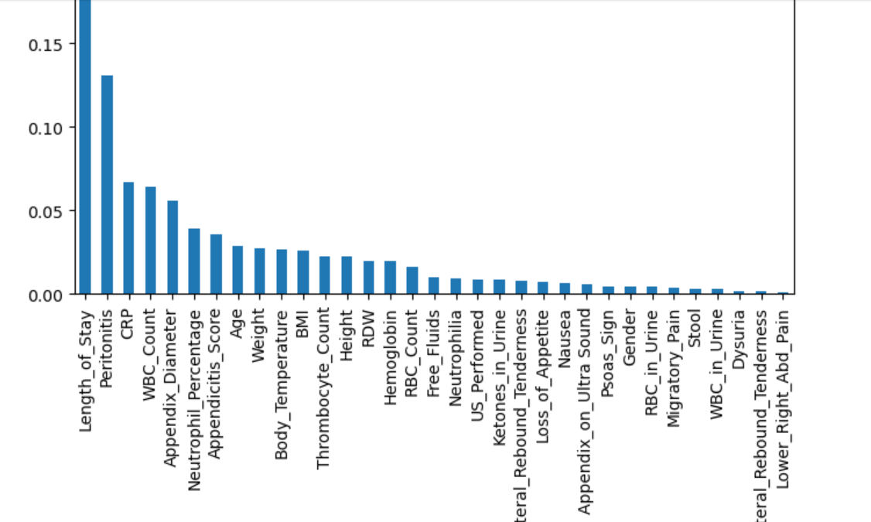
Feature importance
Key Indicators for Diagnosis:
Length of Stay: The highest-ranked feature suggests that patients requiring longer hospital stays may indicate either severe appendicitis or complications. This feature likely reflects disease severity and is relevant for deciding the need for surgical intervention.
Peritonitis: As a critical clinical sign, its high importance underscores its direct relationship with acute appendicitis and the need for surgery. Presence of peritonitis strongly points towards a ruptured or advanced appendicitis case, necessitating immediate surgical action.
CRP (C-Reactive Protein): Elevated CRP indicates systemic inflammation, which is a key factor in appendicitis diagnosis. Higher levels might support a decision for surgery, especially in cases of suspected perforation or abscess formation.
.

Slide 16
Feature importance
2. Supporting Diagnostic Features:
WBC Count: A high white blood cell count is a hallmark of infection and inflammation, aiding in confirming the diagnosis of appendicitis.
Appendix Diameter: Measurements from imaging (e.g., ultrasound or CT scan) showing an enlarged appendix are critical in determining the presence of appendicitis. Larger diameters often correlate with the need for surgical intervention.
Alvarado Score: Features related to this scoring system (e.g., migratory pain, nausea, rebound tenderness) may also contribute, but their importance is lower in this plot
3. Secondary Features:
Features like BMI, Age, Weight, and Temperature have moderate importance. These may be used as contextual factors to understand patient-specific conditions but are not direct indicators for surgery.
Laboratory markers like Hemoglobin, RDW, and RBC Count provide supporting evidence but are less influential compared to direct inflammatory or clinical signs.
Low importance of features like Dysuria, Migratory Pain, and Right Abdominal Pain might indicate that these alone are insufficient for confirming appendicitis or deciding on surgery.

Slide 17
Overall Inference for Appendicitis Management
Indicators Suggesting Surgery May Not Be Required:
Decision for Surgery not required:
Patients with normal CRP, WBC count, and no imaging abnormalities (e.g., normal appendix diameter) might not require surgical intervention and can be managed conservatively, such as antibiotics and observation.
Decision for Surgery:
The decision to operate would heavily rely on top features:
Patients with peritonitis, high CRP, abnormal appendix diameter, and prolonged hospital stays are strong contributors to consider for surgery.
Length of Stay may also indirectly reflect the timing of surgery. Prolonged stays in patients without surgery may indicate delayed resolution or complications.

Slide 18
Thank You

